Slide 1
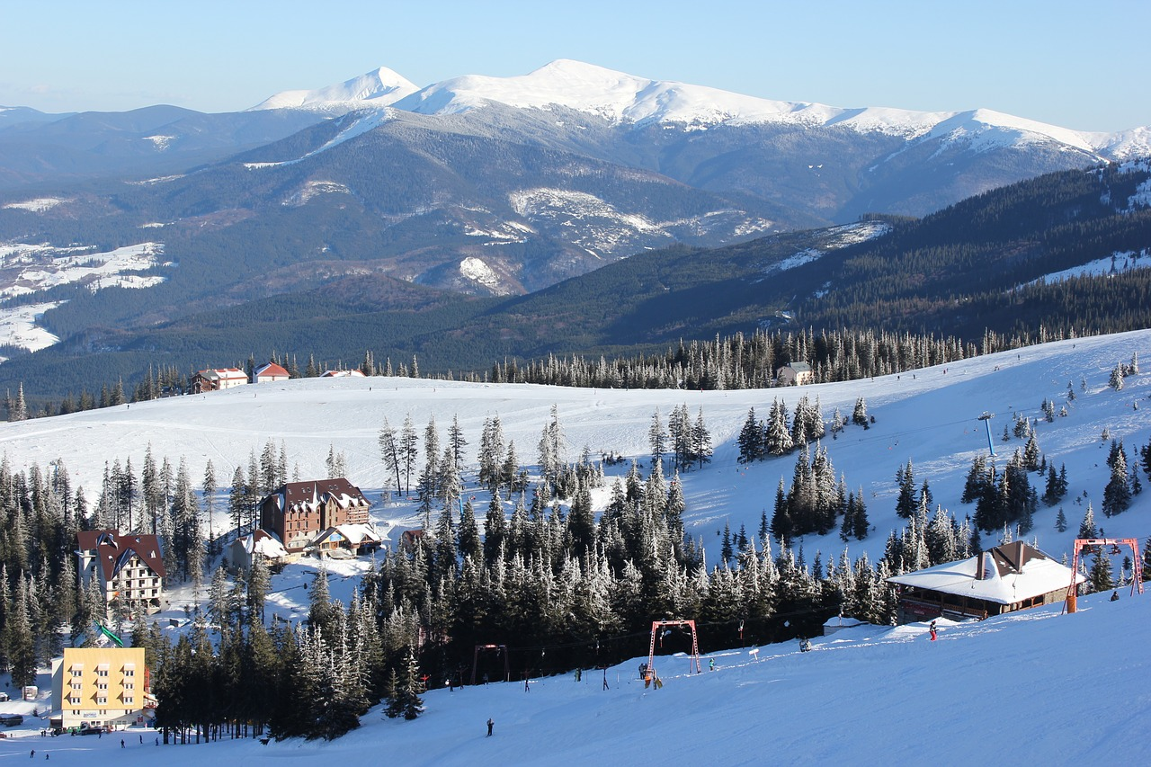
Big Mountain Ski Resort
Lift Ticket Pricing Model

Slide 2
Undervalued?
Current lift ticket price: $81 Vail, Aspen: $200+
Nubs Nob Ski Area , MI: $85
Which one does Big Mountain view as a comparable resort?
In facilities?
In reputation?
In skiing quality?

Slide 3
Proposed Operational Changes
Permanently closing down up to 10 of the least used runs
Increase the vertical drop by adding a run to a point 150 feet lower down but requiring the installation of an additional chair lift to bring skiers back up
Same as number 2, but adding 2 acres of snow making cover
Increase the longest run by 0.2 mile requiring an additional snow making of 4 acres
Close the two T-bars

Slide 4
Recommendations
Raise lift ticket prices to $85
Close up to 5 of the least utilized runs
Shut down the two T-bars
Impacts
Increases prospective revenue by $7M annually
Lowers operating costs to make up for $1.54M increase from new lift
The other proposals did not have enough benefit to offset expenses.

Slide 5
Model
The chosen model utilized price data from 276 resort to predict the price of Big Mountain’s lift ticket. It predicted that the current price would be
$95.87 ± $10 in average error
Random forest model
Works well with small datasets
No need to scale features
Many correlated features are less of a problem

Slide 6
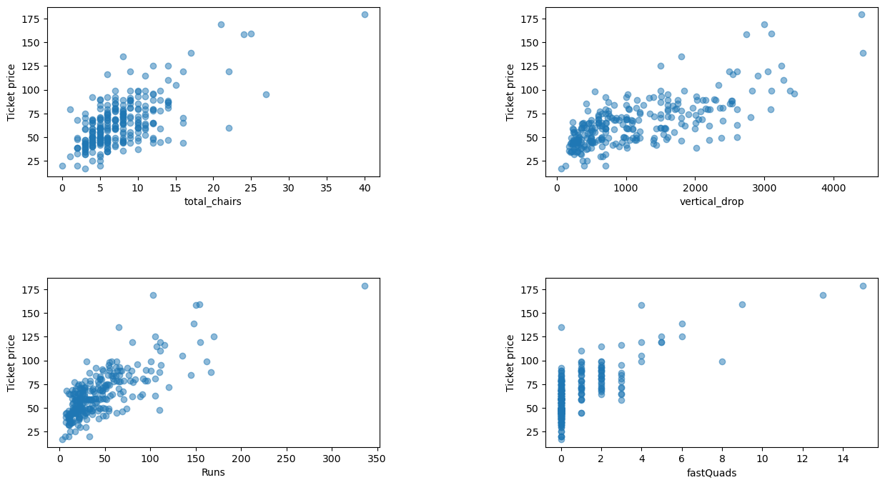
Important Features
The most important features in the model
# of Runs Vertical Drop Total # of Chairlifts | # of Fast Quads Snowmaking Acres Skiable Terrain Acres

Slide 7
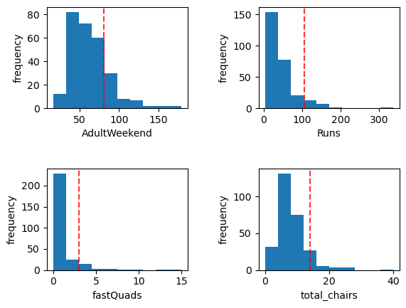
Market Position
These graphs reflect that Big Mountain has Copper Mountain level facilities but is pricing like Nubs Nob.

Slide 8
Conclusions
Big Mountain is currently underpricing lift tickets
A modest $4 increase is easily supported by the data
Projected revenue increases by $7M
With the new lift opening, this is an ideal time to shut down the outmoded T-bars and close underused runs
Future modelling using more detailed analysis of comparable larger resorts may provide insight into additional revenue streams

